Slide 1
Java Programming
3

Slide 2
Instance vs Local Variables
Instance Variable: These variables are declared within a class but outside a method, constructor, or block and always get a default value.
These variables are usually created when we create an object and are destroyed when the object is destroyed.
We may use an access specifier, for instance, variable, and if no access specifier is specified, then the default access specifier is used.
Each and every object will have its own copy of instance variables.
Example:
class Taxes
{
int count; // Count is an Instance variable
/*...*/
}

Slide 3
Instance vs Local Variables
Local Variable: These variables are declared within a method but do not get any default value.
They are usually created when we enter a method or constructor and are destroyed after exiting the block or when the call returns from the method.
Its scope is generally limited to a method and its scope starts from the line they are declared. Their scope usually remains there until the closing curly brace of the method comes.
The initialization of the local variable is mandatory.
Example:
int area()
{
int length = 10; // Local variable
int breadth = 5; // Local variable
int rectarea = length*breadth; // Local variable
return rectarea;
}

Slide 4
Inheritance in java
Inheritance is an important pillar of OOP(Object-Oriented Programming). It is the mechanism in java by which one class is allowed to inherit the features(fields and methods) of another class.
Important terminology:
Super Class: The class whose features are inherited is known as superclass(or a base class or a parent class).
Sub Class: The class that inherits the other class is known as a subclass(or a derived class, extended class, or child class). The subclass can add its own fields and methods in addition to the superclass fields and methods.
Reusability: Inheritance supports the concept of “reusability”, i.e. when we want to create a new class and there is already a class that includes some of the code that we want, we can derive our new class from the existing class. By doing this, we are reusing the fields and methods of the existing class.

Slide 5
Inheritance in java
How to use inheritance in Java
The keyword used for inheritance is extends.
Syntax :
class derived-class extends base-class
{
//methods and fields
}
Types of Inheritance:
1. Single Inheritance: In single inheritance, subclasses inherit the features of one superclass. In the image below, class A serves as a base class for the derived class B.

Slide 6
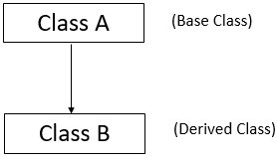
Inheritance in java
Types of Inheritance:
1. Single Inheritance: In single inheritance, subclasses inherit the features of one superclass. In the image below, class A serves as a base class for the derived class B.

Slide 7
// Java program to illustrate the/concept of single inheritance
import java.io.*;
import java.lang.*;
import java.util.*;
class one {
public void A()
{
System.out.println(“parent");
}
}
class two extends one {
public void B() { System.out.println(“child"); }
}
public class Main {
public static void main(String[] args)
{
two g = new two();
g.A();
g.B();
g.A();
}
}

Slide 8
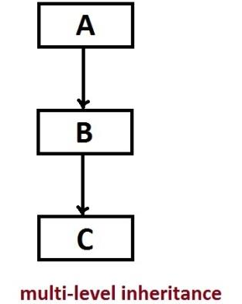
Inheritance in java
2. Multilevel Inheritance: In Multilevel Inheritance, a derived class will be inheriting a base class and as well as the derived class also act as the base class to other class.

Slide 9
// Java program to illustrate the concept of Multilevel inheritance
import java.io.*;
import java.lang.*;
import java.util.*;
class one {
public void A()
{
System.out.println(“main clss");
}
}
class two extends one {
public void B()
{ System.out.println(“child class"); }
}
class three extends two {
public void C()
{
System.out.println(“child class");
}
}

Slide 10
// Derived class
public class Main {
public static void main(String[] args)
{
three g = new three();
g.A();
g.B();
g.C();
}
}

Slide 11
ABSTRACT CLASS
Abstraction lets you focus on what the object does instead of how it does it.
Ways to achieve Abstraction:
There are two ways to achieve abstraction in java
Abstract class (0 to 100%)
Interface (100%)
Abstraction in java
A class which is declared as abstract is known as an abstract class. It can have abstract and non-abstract methods. It needs to be extended and its method implemented. It cannot be instantiated.

Slide 12
ABSTRACT CLASS
Points to Remember:
An abstract class must be declared with an abstract keyword.
It can have abstract and non-abstract methods.
It cannot be instantiated.
It can have constructors and static methods also.
It can have final methods which will force the subclass not to change the body of the method.

